Slide 1
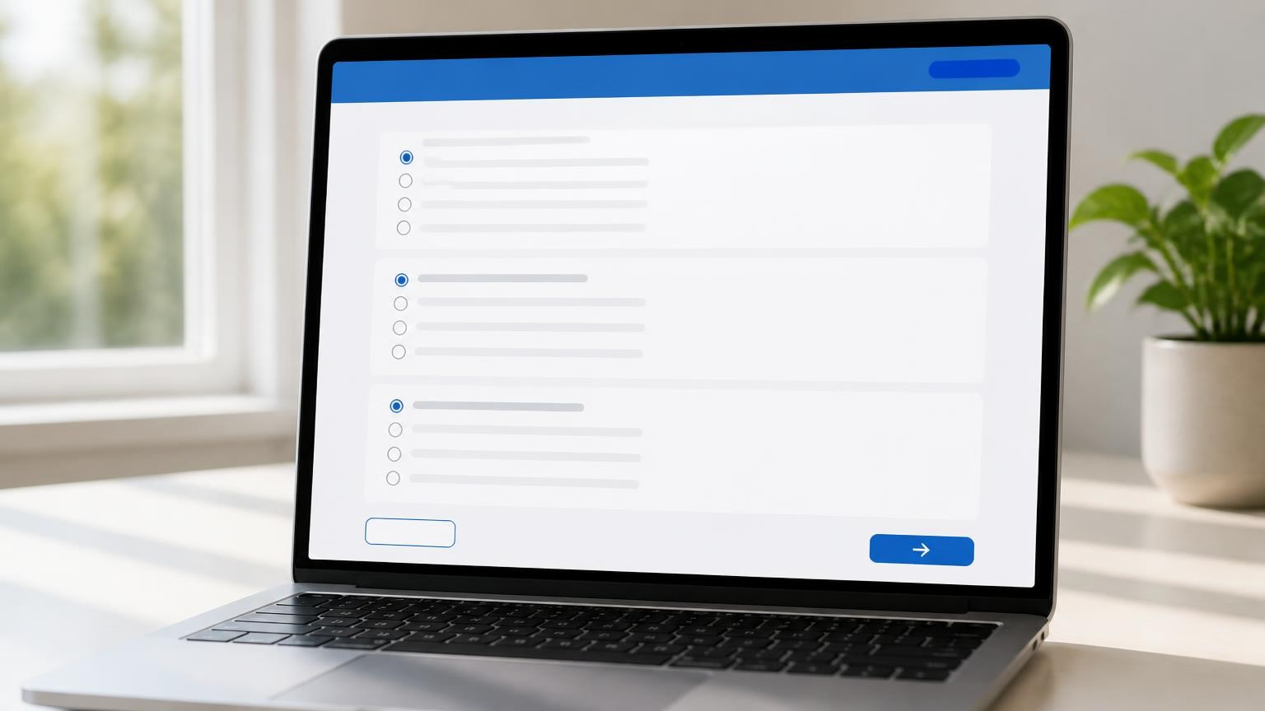
SDC PROJECT REVIEW — 1
B.TECH CSE PROJECT
Online Examination System
A browser-based project built with HTML, CSS, JavaScript, and Local Storage.
B.TECH CSE PROJECT
Online Examination System
A browser-based project built with HTML, CSS, JavaScript, and Local Storage.
SDC PROJECT • ONLINE EXAMINATION SYSTEM

Slide 2





01 — PROBLEM STATEMENT
Why an Online Examination System?
Traditional Limits
Remote Access
Physical classrooms, printed papers and manual evaluation slow down the process.
Students and applicants can take tests from anywhere with a browser.
Admin Control
Instant Results
Instructors create question banks, prepare quizzes and set time limits.
Secure login, timed exams, automatic evaluation and answer review.
This project demonstrates the full flow. It brings an objective test from setup through result into one client-side experience.
02 / 15
CONTEXT

Slide 3
02 — PROJECT OBJECTIVES
What this project delivers
1
Simple, user-friendly online examination platform
2
Separate Admin and User modules with role-based access
3
Signup & Login powered by browser Local Storage
4
Admin tools to manage questions and examinations
5
Randomized exams with live countdown timer
6
Automatic evaluation of MCQs with instant results
7
Answer review and feedback after submission
03 / 15
GOALS

Slide 4


03 — BUSINESS SYSTEM & MODULES
Online Assessment / Examination Management
Admin Module
User Module
▸ Admin login and dashboard
▸ Signup and login
▸ Create, edit and delete questions
▸ View available examinations
▸ Create / manage examinations & time limits
▸ Attend randomized questions with timer
▸ View user attempts and results
▸ Submit exam, view score & review answers
04 / 15
ARCHITECTURE

Slide 5





04 — TECHNOLOGIES USED
Frontend-only stack — no backend required
HTML5
CSS3
JavaScript
Local Storage
Git & GitHub
Page structure and application components
Styling, responsive layout, Grid & Flexbox
Logic, validation, navigation & exam processing
Signup/login data stored in the browser
Version control and repository hosting
No backend, database or external framework is required for this SDC project.
05 / 15
STACK

Slide 6
05 — UI DESIGN • GRID & FLEXBOX
Layout structure with CSS Grid & Flexbox
HEADER — Logo / Title • Navigation
SIDEBAR
Admin / User menu
Module links
MAIN AREA
Forms • Questions • Results
FOOTER
Project info
CSS Grid structures the overall dashboard; Flexbox aligns navigation, buttons, cards and form elements.
CSS - Shapes the responsive layout, cards, states, and visual hierarchy.
06 / 15
LAYOUT

Slide 7
06 — SIGNUP & LOGIN • LOCAL STORAGE
Client-side authentication flow
01
Signup Form
Collects name, email/ID and password. JavaScript validates before registration.
02
Local Storage
User details are stored in the browser Local Storage on the client side.
03
Login Check
Credentials are matched against stored data. Successful login redirects by role.
04
Logout
Clears current session information and returns the user to the landing page.
07 / 15
AUTH

Slide 8
07 — MODULE-WISE NAVIGATION
Navigation controlled by JavaScript event handlers
Landing Page
→
Signup / Login
Login
→
Role detection (Admin / User)
Admin
→
Dashboard → Question Bank / Exams / Results
User
→
Dashboard → Available Exam → Exam Page
Exam Page
→
Submit → Result & Answer Review
08 / 15
FLOW

Slide 9





08 — EXAMINATION WORKFLOW
End-to-end client-side exam flow
→
→
→
→
→
→
Login
Select
Exam
Random
Questions
Timer
Submit
Evaluate
Result
Each attempt is processed completely on the client side using JavaScript — no server round-trips required.
09 / 15
PROCESS

Slide 10



09 — SECURITY & ANTI-CHEATING
Basic client-side security measures
Question Randomization
Countdown Timer
Tab Visibility Warning
Order of questions is shuffled for every exam attempt.
Auto-submits the exam when the time limit expires.
Warns the user if the exam tab or window is hidden.
Answer Validation
Credential Checks
Client-Side Scope
Prevents submission without selecting required answers.
Validates login before opening protected modules.
Provides basic protection; not full server-level security.
10 / 15
SECURITY

Slide 11
10 — MAJOR FUNCTIONALITIES
Key capabilities at a glance
Admin Tools
User Access
Randomization
Countdown Timer
Manage question bank and examinations
Signup, login and take examinations
Fresh question order on every attempt
Automatic submission on time expiry
MCQ Evaluation
Score & %
Answer Review
Responsive UI
Instant automatic scoring of objective questions
Immediate score and percentage calculation
Correct / incorrect feedback after submission
Grid & Flexbox for all screen sizes
11 / 15
FEATURES

Slide 12
11 — GITHUB DEPLOYMENT
Version control & repository setup
1
Create a GitHub repository for the project
2
Add HTML, CSS and JavaScript source files
3
Commit with meaningful messages
4
Push the complete project to GitHub
5
Ensure repository contains all required assets
6
Demonstrate the repository during the review
12 / 15
DEPLOYMENT

Slide 13
12 — DEMONSTRATION PLAN
Live walkthrough sequence
1
Open the application home page
2
Demonstrate user Signup and Local Storage data
3
Demonstrate Login and role / module redirection
4
Open Admin Module and show question / exam management
5
Open User Module and start an examination
6
Show random questions and countdown timer
7
Submit the exam and demonstrate instant result
8
Review answers and show the GitHub repository
13 / 15
DEMO

Slide 14
13 — CONCLUSION
A complete working frontend application
Digital Solution
SDC Requirements
Pure Frontend
Simple platform for conducting online assessments without physical infrastructure.
Fully satisfies requirements with distinct Admin and User modules.
Built entirely with HTML, CSS and JavaScript — no backend needed.
Local Storage Auth
Rich JS Logic
Demo Ready
Client-side signup and login using browser Local Storage.
Handles navigation, randomization, timing, evaluation and feedback.
Ready to be demonstrated as a complete working application.
14 / 15
SUMMARY

Slide 15
THANK YOU
Questions & Demonstration
SDC PROJECT • ONLINE EXAMINATION SYSTEM

